Slide 1

UNIVERSITY OF PETROLEUM & ENERGY STUDIES
School of Computer Science
Dehradun
COURSE: IT Security
July – December 2023
Delivered by
Dr. Gopal Singh Rawat
1

Slide 2
Course Plan
Introduction to IT System Security
Operating System Security
Endpoint Security
Application Server Security
Database Server Security
IT System Security Processes

Slide 3
Unit #6: IT System Security Processes

Slide 4
6.1 What is IT System Security:
This covers everything from prevention, detection and response to improper access from within & outside an organization, to protect information and systems
What is Security Policy:
Deﬁnes goal, course or method of action to guide and determine present and future decisions concerning security in an organization.
Set of Rules or Principles that direct how a system or an organization provides security services to protect sensitive and critical system resources.
Security policy is enforced:
by individuals → Security Procedures and Policies
by devices in the physical environment → Access control, Key/Locks, Cards, ID, Cameras, Sensors, Alarms
by automated mechanisms → implemented in Hardware, Firmware and Software (Configuration)
Types of IT Threats:
Insider (Internal) Attacks
Outsider (External) Attacks
Logic Bombs
Trap Doors
Login Spoofing
Virus
Worm
Trojan Horse
Rootkit
Ransomware
Adware
Spyware
Keylogger
Zombie (Bot)

Slide 5
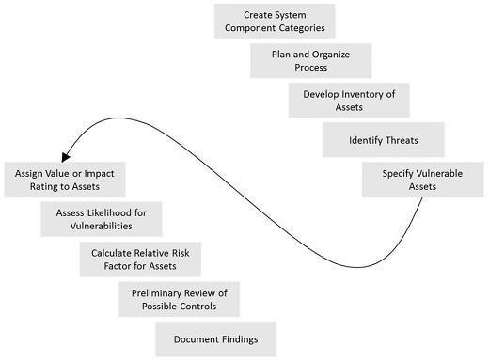
6.2 Identify RISK

Slide 6
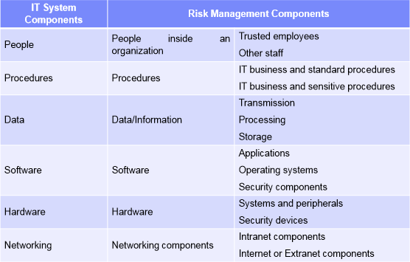
6.2 How do we identity RISK
Begins with Self Examination of Assets (Inventory)
Recognize data resources
Sort them into significant gatherings
Organize them by their significance

Slide 7
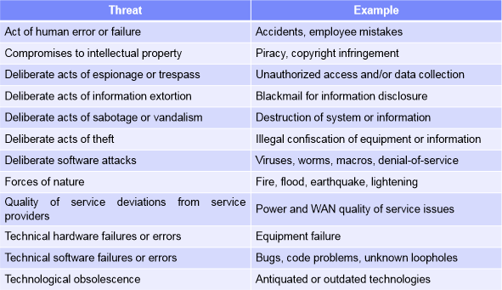
6.3 Identify THREATs
Begins with classifying any danger that will attack the data source (assets)
Distinguish and Prioritize Threat Agents
Hazard Identification

Slide 8
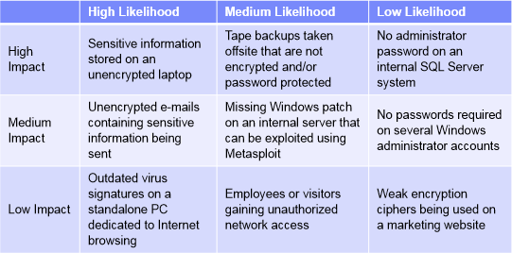
6.4 Prioritize System Vulnerabilities
#1 Likelihood of abuse → How likely is it… Malware or Phishing attack, Old Anti-virus signatures present?
#2 Impact if abused → How harmful would broke down had been misused?

Slide 9
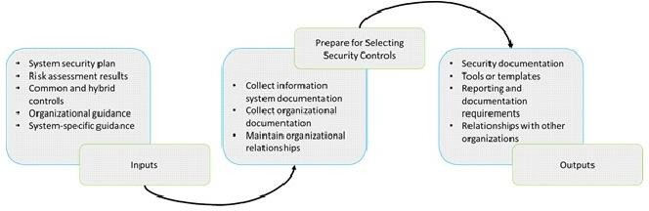
6.5 Selecting Security Controls
Collect Available System & Organizational Documentation:
Plan → System categorization, System description and Architecture, and interconnections with other systems
Risk Assessment Results → Summary of Potential threats and Vulnerabilities of the system
Plan Baseline Control – Lookup others & compare with yours
Lookup Initial Security Baseline as per peers, industry, standards others
Document your initial security baseline
Lookup Minimum Assurance Requirements
Document your Minimum Assurance Requirements

Slide 10
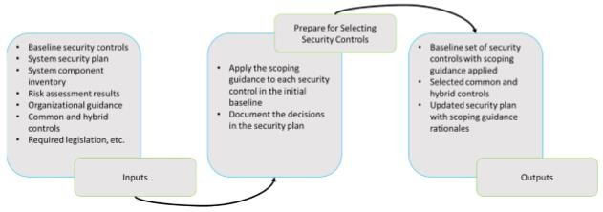
6.6 Apply Scoping Guidance
Apply Security Objective related Considerations
Apply Common Control related Considerations
System Component Allocation related Considerations
Apply Scalability related Considerations
Document decisions on Security Plan

Slide 11
Analyzing System Environment
System → Connected to the Internet
Location → Overseas, Harsh environment
Implementation → Software deployment – rapid
Platform → open source, network is not secure, shared by other organizations / departments, public traffic also flows
Application → processing is secure, inside organization’s controlled facility
Backup → alternative ISP available, has low bandwidth

Slide 12
Security in System Lifecycle
#1 Initiation Phase
Starting Stage
Here you specify → System Requirement (What is needed) and Reason (Why is it needed)
#2 Development / Acquisition Phase
System is organized
Exact model/make of system is Outlined & Specifications Modified
Vendors contacted, PoC done, Purchase Order released, Bought
#3 Implementation Phase
System is configured and application setup as per security controls required
Technical Staff training and certification done
System is tested on few, Released into Production (for real-time use)
#4 Operations Phase
Continually & Constantly adjusted (Fine tune)
By expansion of program modules/equipment (WAF/Threat Feeds) or by new threats/attacks/integrations
Operations pertaining to Security and Administration

Slide 13
6.8 Security in System Lifecycle
Operations pertaining to Security and Administration:
Security Admin exercises
Holding tutoring directions
Completing reinforcements
Handling cryptographic keys
Keeping up with individual organization and access controls
Operational Assurance:
whether a device worked steady with its contemporary security necessities.
Audits and Monitoring:
System review (one time or occasional check and observe)
Staff Security, Partition of Duties, IT/Server Room access
Physical & Environmental Defense
Access Control
Fire Safety
Mobile & System security
Disposal Phase:
All documents are arranged properly, irrelevant documents removed and IT system life cycle is finished.
Data Integrity Controls

Slide 14
6.8 Security in System Lifecycle
Data Integrity Controls
Are tools placed in environment to prevent data integrity issues – detect Password crackers, IDS, Network Scanners
Was Vulnerability Assessment on App/OS done – Penetration Testing – check & remove vulnerabilities (OWASP Top10)
Is the Endpoint Security solution able to detect any Malicious Programs or Traffic Anomalies (or Anti XX Server logs)
Does the Email system support Message Authentication – spam and sender detections
Data Tempering errors – check View/Access Logs, Encryption, Hashes, Checksums
Use of Data Loss Prevention (DLP)?

Slide 15
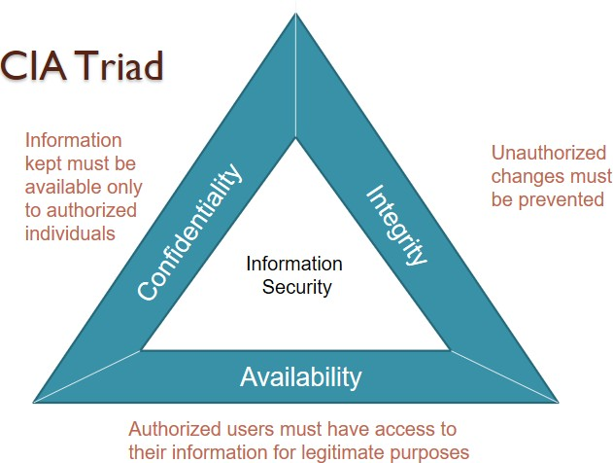
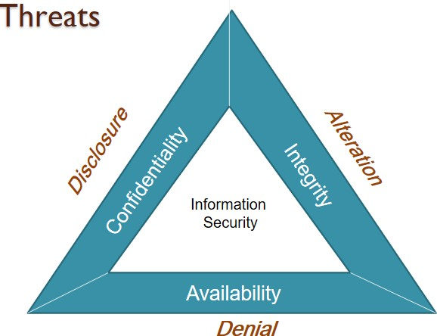
6.9 CIA Triad:
Known model for Security Policy Development

Slide 16
6.9 CIA Triad:
Confidentiality:
Ensures sensitive information is accessed only by authorized persons
Kept away from those not authorized to possess them
Implemented using
Usernames/ Passwords, Groups, Access Control Lists (ACLs) and Encryption
Common for information to be categorized according to the extent of damage that could be done should it fall into unintended hands.
Security measures can then be implemented accordingly
Covers aspects
Data Disclosure – private & confidential information is not made available to unauthorized persons
Data Privacy – assures that information owners control or influence (related to them)
What information may be collected & stored
By whom
To whom that information will be disclosed

Slide 17
6.9 CIA Triad:
Integrity:
Ensures information is in a format that is true and correct to its original purposes
Receiver of the information must have the information the creator intended him to have
Information can be edited by authorized persons only and remains in its original state when at rest
Implemented using
Data Encryption and Hashing
Covers aspects
Data Integrity – assures that data & programs are only changed in specific (predefined) & authorized manner
System Integrity – system performs its intended function, free from deliberate or unauthorized manipulation

Slide 18
6.9 CIA Triad:
Availability:
Ensures information and resources are available to those who need them, promptly made available & not denied to authorized users
Implemented using
Hardware maintenance, Software patching and Network optimization
Include Redundancy, Failover, RAID and High-availability (HA) Clusters
Dedicated hardware devices can be used to guard against downtime and unreachable data due to malicious actions such as distributed denial-of-service (DDoS) attacks.
Covers Aspects
Disruption of access to resources

Slide 19
6.10 Identify THREATs
Examples of CIA Threats
Snooping / Spying: (Passive) Wiretapping (record calls)
Modiﬁcation / Alteration: (Active) Wiretapping (listening live calls) & Man-in-the-middle
Masquerading (Spooﬁng): Impersonation with intent to deceive, Proxy Attendance
Repudiation of Origin: False denial that an entity sent something
Denial of Receipt: False denial that an entity received something
Delay: Temporary inhibition of a service
Denial of Service: Long term inhibition of a service

Slide 20
6.10 VULNERABILITY – THREAT - ATTACK
Vulnerabilities:
Gaps & Weakness in protection efforts / process
Leaky : loss of Conﬁdentiality
Corrupted: loss of Integrity
Unavailable or very slow: loss of Availability
Threats:
Capable of Exploiting Vulnerabilities
Represent potential security harm to an asset
Attacks
Threats carried out
Passive:
Attempt to get/make use of information from system, but not aﬀect the system resources
Active
Attempt to alter system resources or aﬀect their operation
Insider: initiated by an entity inside the security parameter (Staff / employees / Logic Bombs)
Outsider: initiated from outside the perimeter (Internet)

Slide 21
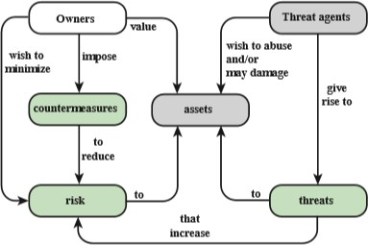
6.11 Relationship of Security Concepts

Slide 22
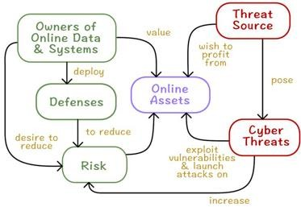
6.11 Relationship of Security Concepts

Slide 23
6.12 Security in System Lifecycle
Media Sanitization:
Data is irreversibly removed from media or the media is permanently destroyed.
Data Cleansing or Data Cleaning:
Process of detecting and correcting (or removing) corrupt or inaccurate records from a record set, table, or database
Refers to identifying incomplete, incorrect, inaccurate or irrelevant parts of the data and then replacing, modifying, or
deleting the dirty or coarse data.

